Slide 1
Cambridge Analytica
Could it happen again?

Slide 2
What was
Cambridge Analytica?
Cambridge Analytica Ltd, created in 2014
Main contributor was an Robert Mercer
The company was founded on the idea of using Facebook data.
Notes:
So, probably most of you have heard about the Cambridge Analytica scandal, but just incase you havent i will quickly go over what the company was! Cambridge Analytica was a British political consulting firm that was created in 2014 and was primarily funded by the American hedge-fund billionaire Robert Mercer.
As was described by, Christopher Wylie, the whistleblower who uncovered the scandal, as a company that was founded on the idea of utilising facebook data.

Slide 3
So what happened?
It was a company that sought to obtain the data of as many facebook users as possible.
To do this it used an app called “This is your digital life”.
From which, the data of 87 million people was obtained.
It utilised this data to identify voters whose opinions could potentially be targeted and influenced.
Notes:
So, what exactly happened?
Well, the company sought to obtain the data of millions of people on facebook.
In order to do this they used a Facebook app named “This is your digital life”, from which, Cambridge Analytica was able to gather data on 87 million facebook users, the vast majority of whom gave no consent for their data to be utilised in the way it was. (So there is a chance some of us in this room might have even been involved.)
Only 270,000 people actually used the app, but by virtue of special permissions that facebook was able to allow for, the app was able to access the data of all those people’s friends list, and that's how it got to 87 million.
This dataset ultimately was gathered to be used in an advertisement scheme that would seek to influence millions of voters.

Slide 4
What data was taken?
Status updates
Private messages
Likes
Shares
Mercury is the closest planet to the Sun
Notes:
… even in some cases people’s personal messages!
Cambridge Analytica was able to build a fairly comprehensible data-set that would allow them to identify groups of individuals that were of a certain political persuasion, or had the potential to be influenced by their advertisement scheme.

Slide 5
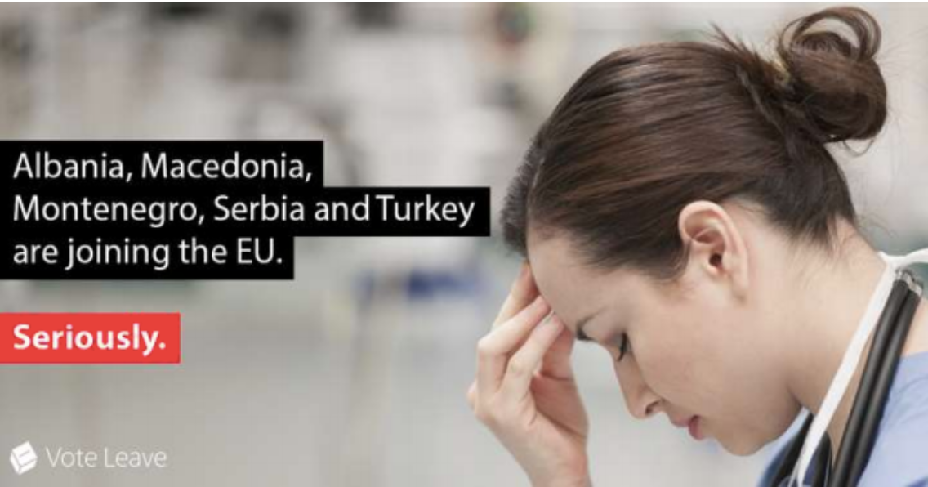
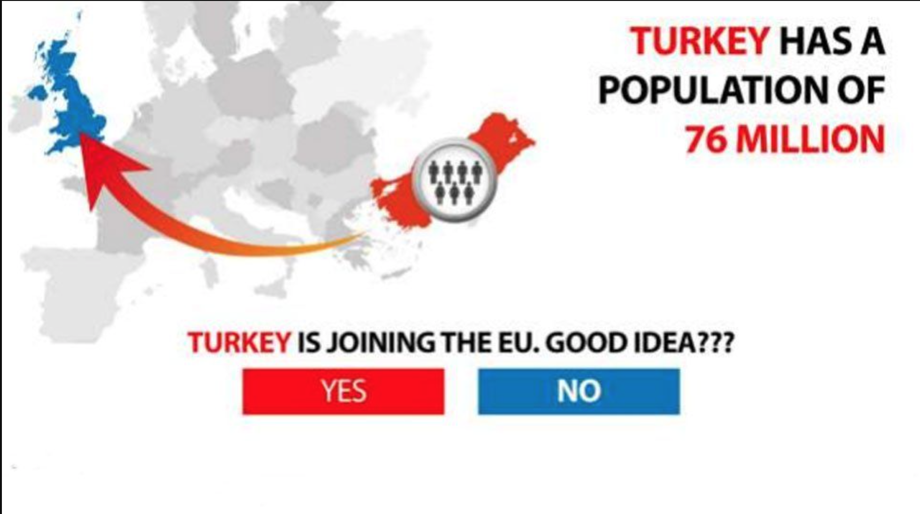
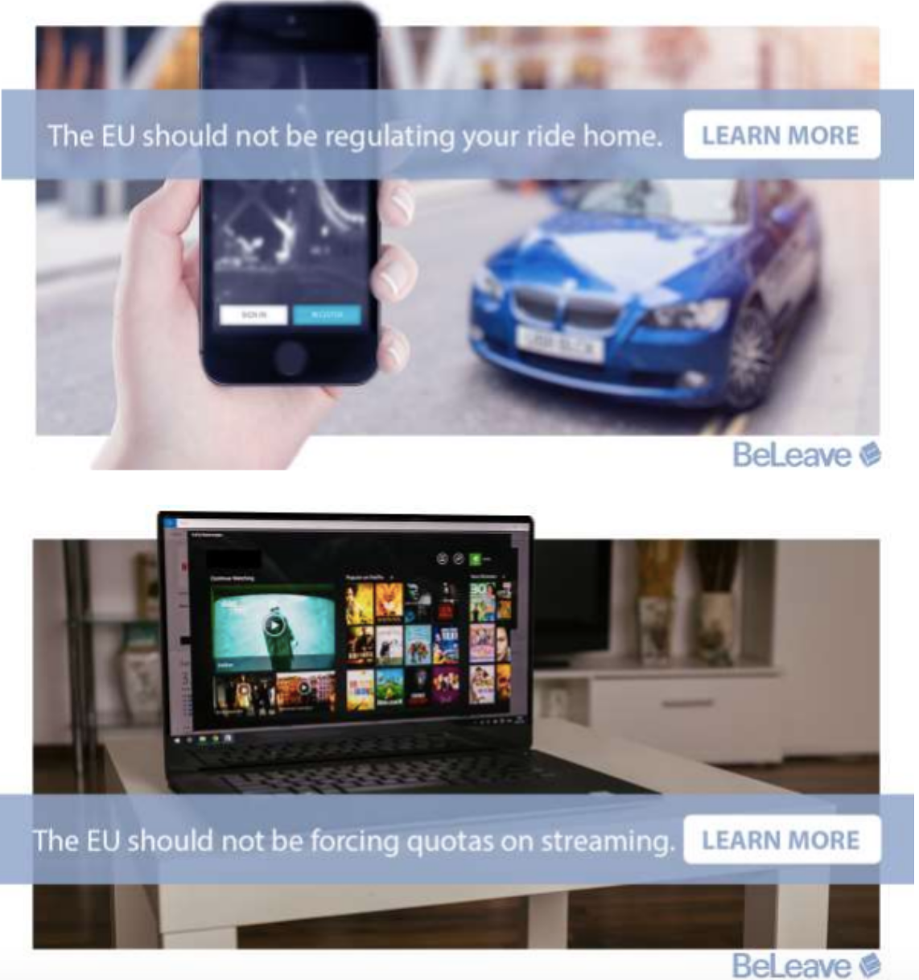

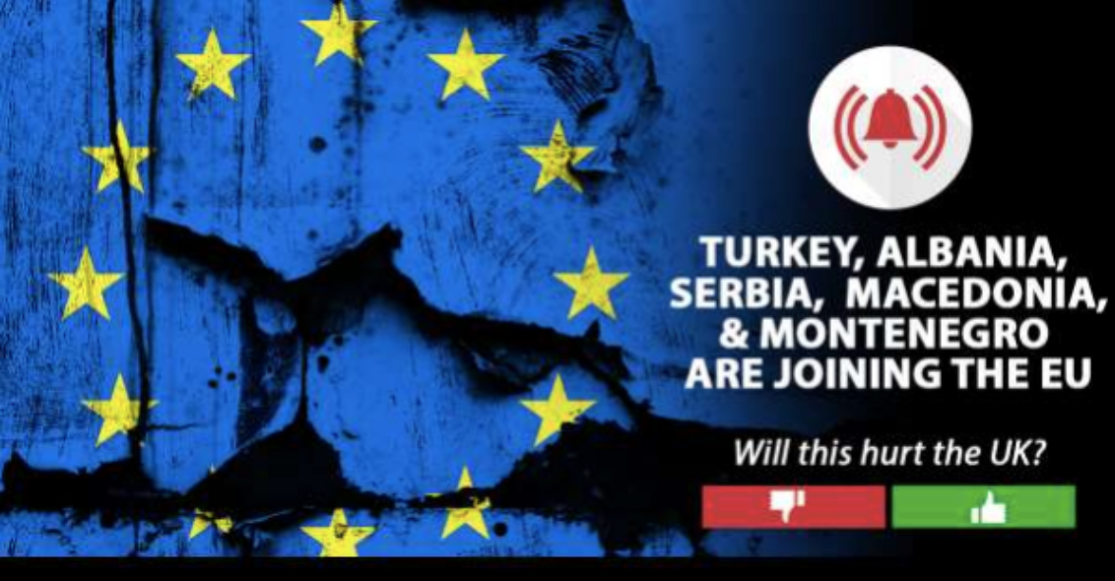
Notes:
Once the individuals were identified as potential targets that could be influenced, they were bombarded with hundreds of facebook ads mere days before the US election and the Brexit vote in 2016. Many of these adverts were also false, or very misleading as facts were not necessarily important, it was more about targeting the fears of those that had been identified from the data.
These were some of the adverts that are believed to have been used during the Brexit vote.

Slide 6
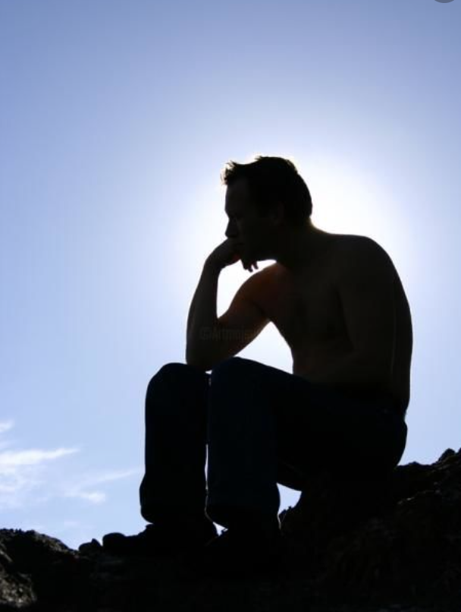
Can these events be avoided in the future?
Notes:
Whether or not the Cambridge Analytica scandal had a significant enough influence to have changed the course of the UK brexit vote, or the 2016 US election for Donald trump is likely but unlear, but importantly the mere fact that this was potentially the key factor is alarming.
It was an incident that challenged the integrity of democracy for today and potentially for the future.
Can incidents like these be avoided in the future?
Many see the incident as an institutional failure. Although in the fallout of the scandal, it appears that many people involved in it have gotten away with it. I found an interview with Martin Moore - the director of the Centre for the Study of Media, Communication and Power at King’s College London and when asked why more hasnt been done, he said we are only really beginning to understand the scale of the potential problem, and methods to deal a crisis like this is vast.
I spent some time online trying to find some clever ideas on how we ensure elections and referendums remain free from interference, and struggled to find much that would amount to a concrete answer to solve the issues.
But
Education is a good start, to learn to spot when an advert is potentially trying to mislead us.
More security around our own data. Data in the 21st century is a precious commodity that on mass has the potential to be used for some pretty nefarious things, so it needs to be protected!
And lastly, some transparency in how the media.

Slide 7
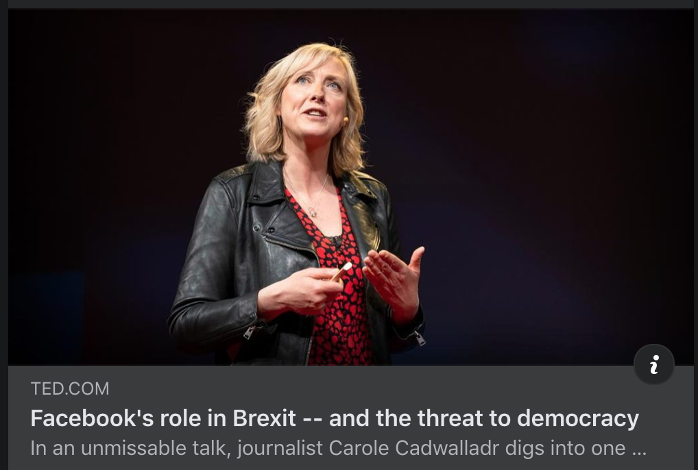
Notes:
If anyone is interested, I found this tedtalk a couple of years back by the journalist Carole Cadwalladr who herself uncovered a lot of details about how the facebook advertising campaign affect the outcome of brexit. Just DM me on Slack and I can send you the link.

Slide 8
Thanks!
Questions?

